Slide 1
Programming with C and Python For Newbies
Day 9: User_input, Loops: for and while loops

Slide 2
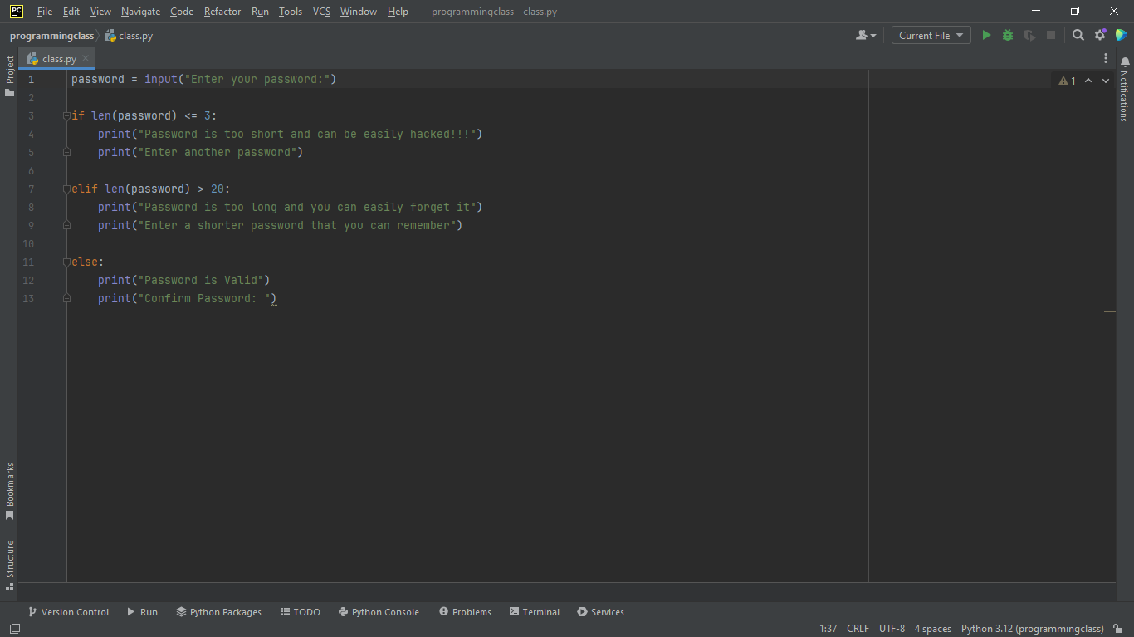
User_input
In python, we use the input function, input() to get users input which is now used to perform some operations.

Slide 3
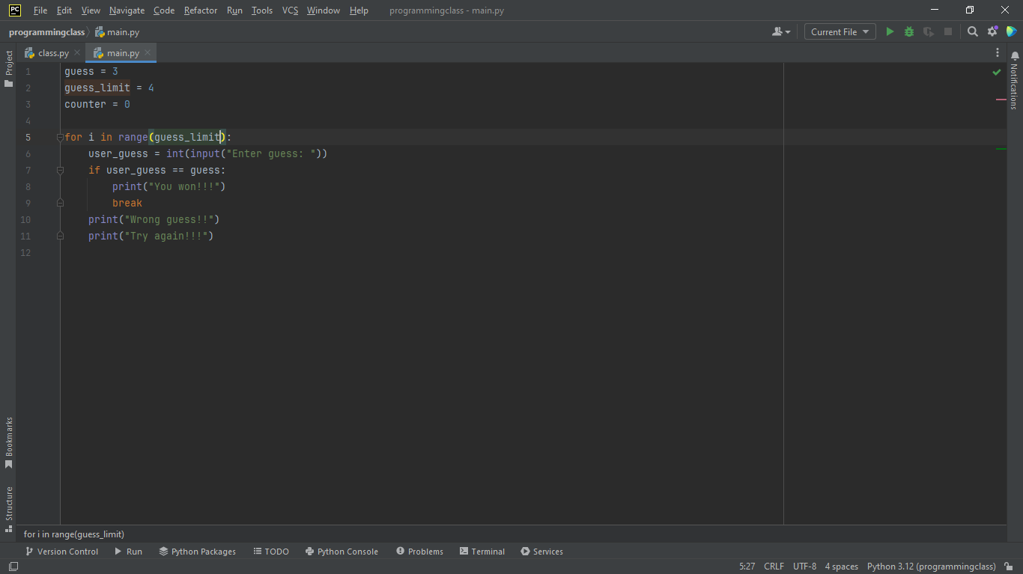
For loops
This is used when you know exactly how many times you want to repeat a block of code.

Slide 4
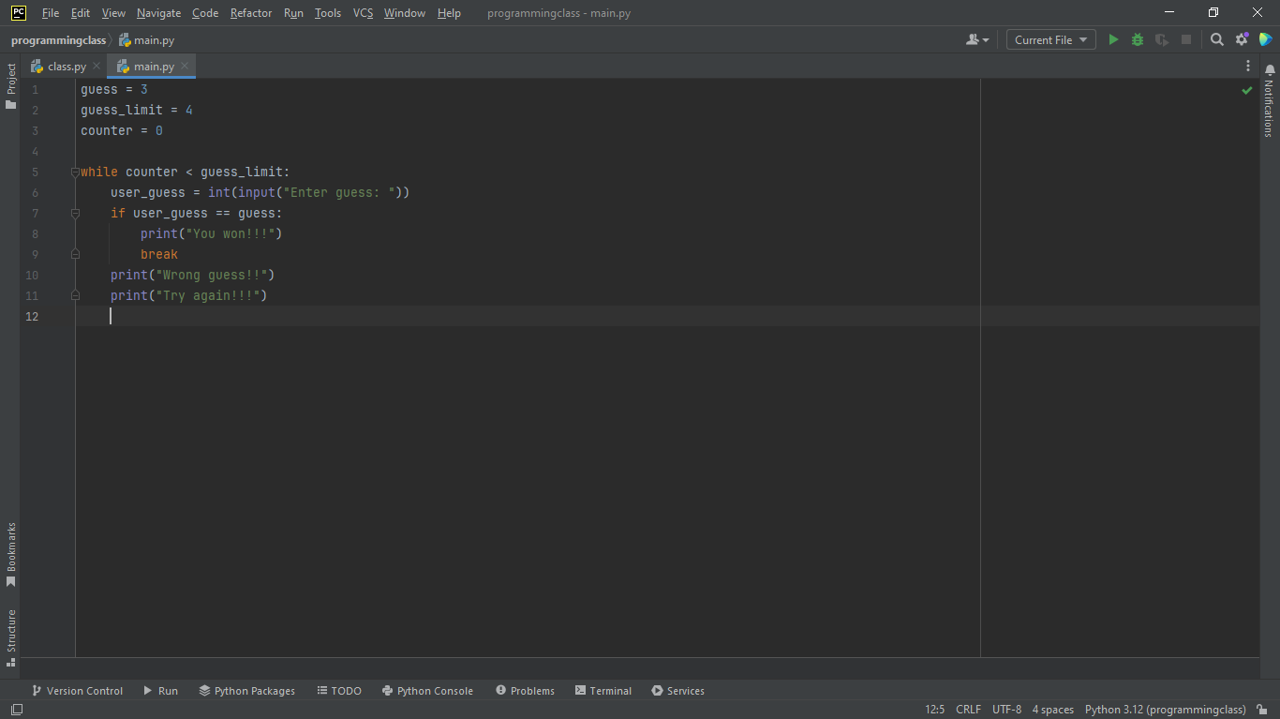
While loop
This loop is often used when you don’t know in advance how many times you’ll loop.
It takes only one argument which is the condition when you want to stop

